Slide 1
Full text search with Django and PostgreSQL
Thomas Aglassinger

Slide 2
Agenda
About Django, PostgreSQL and Project Gutenberg
Example project with plain SQL-Search
Full text search
  PostgreSQL search queries
  Ranking
  Full text search index
  Weights
  Language configurations, stopwords and stemming
Overview: Advanced features

Slide 3
About

Slide 4

About Django
Python-based web framework
free and open-source
https://www.djangoproject.com/
Includes: ORM, template engine, localization, ...

Slide 5

About PostgreSQL
Relational database management system (RDBMS)
https://www.postgresql.org/
Some advanced features:
  full text search
  GIS coordinates
  JSON datatype and queries
  time series
  complex reporting queries
  (windowing, common table expressions, ...)
Supported by Django out of the box

Slide 6

About Project Gutenberg
Collects public domain eBooks
https://www.gutenberg.org/
Can also be downloaded locally
  For example using rsync https://www.gutenberg.org/help/mirroring.html
  Offline catalogs: https://www.gutenberg.org/ebooks/offline_catalogs.html
  Metadata quality somewhat low, though

Slide 7
Example project

Slide 8
Example project
Available from GitHub https://github.com/roskakori/django-search-example
“main” branch contains naive search based on SQL “like” operator
Later branches gradually introduce more advanced search features
Pull requests allow to view the code necessary to add these features
  Won’t be merged to remain “educational”

Slide 9
Example project
Project setup
  Check README
  Includes a docker-compose.yaml to start a PostgreSQL server via docker
MIT license
  can be used as basis for own, even commercial projects
Limitations
  Minimal user interface with no sense for design.
  Only imports text. Image links are broken.
  Only fit for local usage. Look for “TODO Production” comment for hints what needs to be done to make it production ready.
  Hardcoded local database, default password and SECRET_KEY. Extend settings.py to use environment variables instead.

Slide 10
Tasks

Slide 11
Tasks
#2 Add advanced search queries
  Allow search queries with boolean operators, phrases and prefix-search
  https://github.com/roskakori/django-search-example/issues/2
#3 Add ranking
  Sort search results by rank
  https://github.com/roskakori/django-search-example/issues/3
#4 Add search index
  Improve performance of search by indexing
  https://github.com/roskakori/django-search-example/issues/4
#5 Add weights
  Weight findings differently depending on the field it is found in (for example, title vs body text)
  https://github.com/roskakori/django-search-example/issues/5
#6 Add search headline
  Add a preview where in the text the search query was found
  https://github.com/roskakori/django-search-example/issues/6
#7 Add language support
  Use stopwords and stemming depending on language of the text
  https://github.com/roskakori/django-search-example/issues/7

Slide 12
#1 Add naive search based on SQL-Like
https://github.com/roskakori/django-search-example/issues/1
Code already found in main
Allows to search for single words very slowly using SQL “like” operator

Slide 13
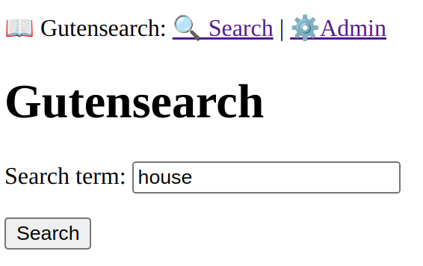
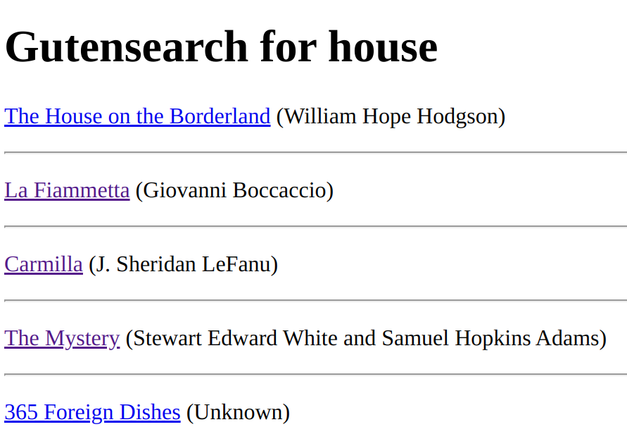
#1 Add naive search based on SQL-Like
Already found in main
Allows to search for single words very slowly

Slide 14
#1 Add naive search based on SQL-Like

Slide 15
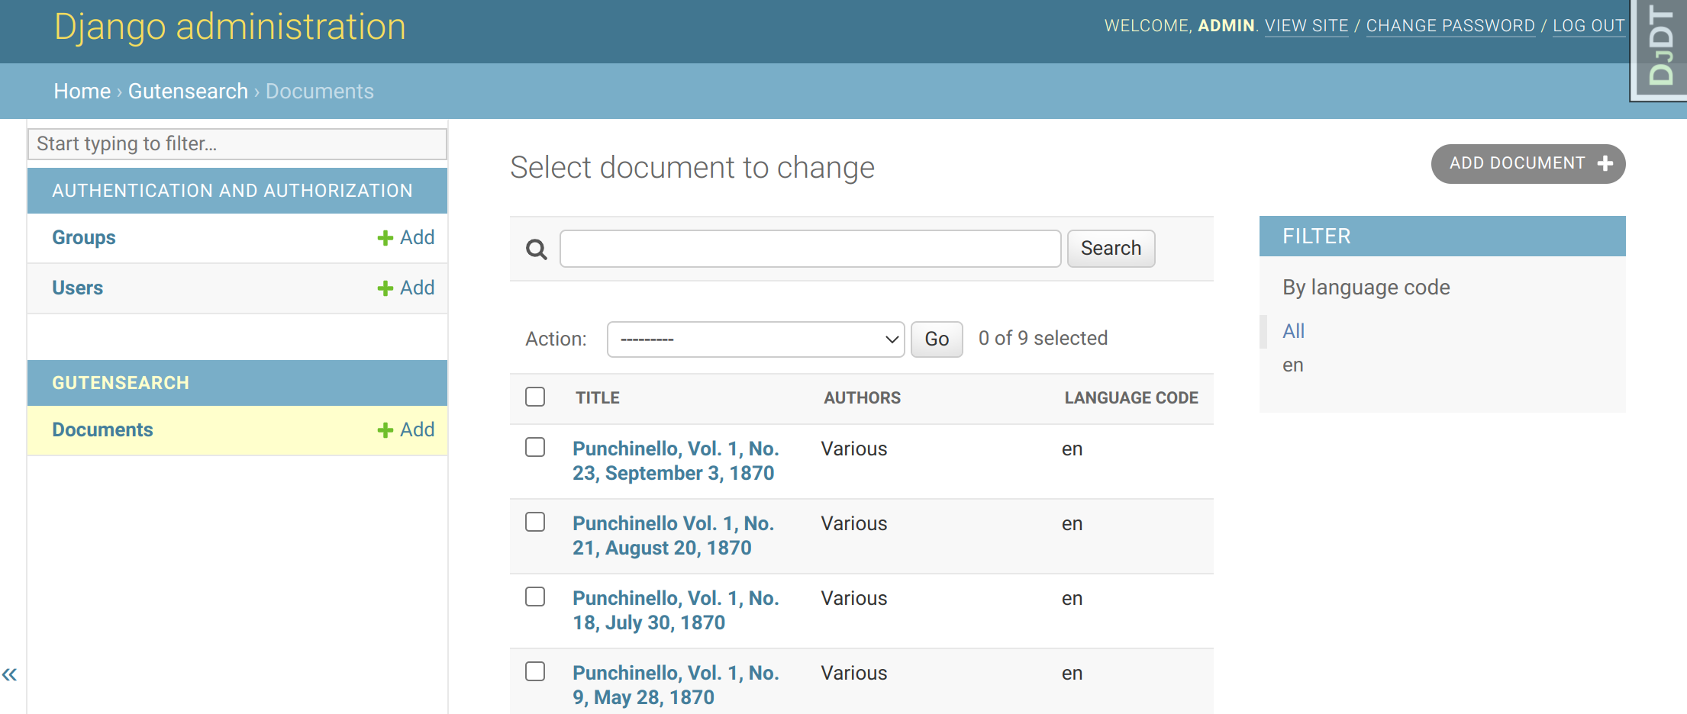
#1 Add naive search based on SQL-Like
Managed command gutenlader can import more documents
Example:
python manage.py gutenlader --max-count 100
Imported documents can be views in Django admin site

Slide 16
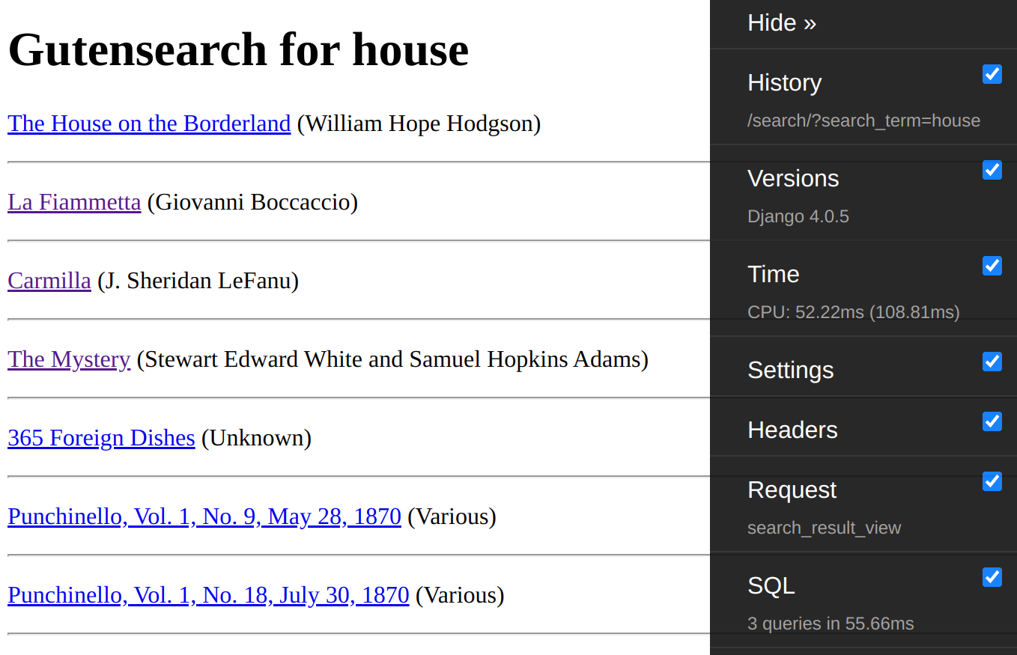
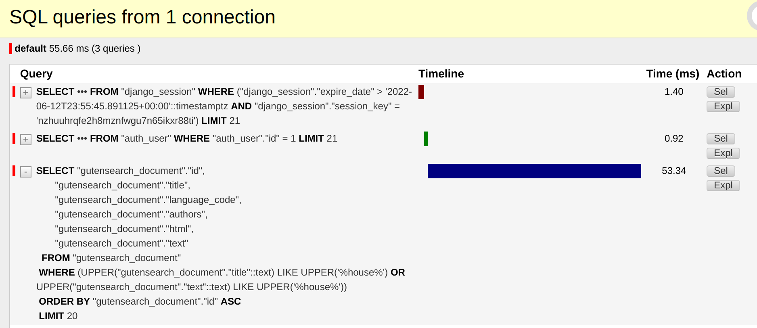
#1 Add naive search based on SQL-Like
Django Debug Toolbar’s SQL tab allows to examine the performance of the search

Slide 17
#2 Add advanced search queries
https://github.com/roskakori/django-search-example/issues/2
Options supported by PostgreSQL “raw” search query parser:
  some – Find all documents containing word “some”
  ‘some’ – same as above
  some & other – documents containing both “some” and “other”
  some | other – documents containing “some” or “other” or both
  ‘some other’ – documents containing the phrase “some other”
  some:* - documents containing words starting with “some” (prefix search)
PostgreSQL has more parsers, but they are all pretty pointless
In practice: Preprocess the search query entered by the user and convert it to a “raw” query.

Slide 18
#3 Add search ranking
https://github.com/roskakori/django-search-example/issues/3
TODO

Slide 19
#4 Add search index
https://github.com/roskakori/django-search-example/issues/4
TODO

Slide 20
#5 Add weights
https://github.com/roskakori/django-search-example/issues/5
TODO

Slide 21
#6 Improve rank of long documents
https://github.com/roskakori/django-search-example/issues/6
TODO

Slide 22
#7 Add search headline
https://github.com/roskakori/django-search-example/issues/7
TODO

Slide 23
#12 Add language support
https://github.com/roskakori/django-search-example/issues/12
TODO

Slide 24
Advanced and missing features

Slide 25
Advanced and missing features
Synonyms
  Use PostgreSQL dictionary for single word synonyms and thesaurus for phrase synonyms
  Caveat: can only be configured on the PostegreSQL server, not with SQL statements
Fuzzy search
  Not supported in the way for example Solr does using the Levenshtein distance.
  If you only want to handle typos, use the Ispell dictionary or pre-process the search query so that typos are fixed there
  For some application, the trigram word distancemight suffice.
Rank debugging
  Not supported in the way for example Solr has a “debug” flag for queries.
Pattern search: * and ?
  Not supported except * for prefix search

Slide 26
Scaling
Search in a separate database
  Improves performance of single search query in case the database would otherwise be used for other queries and to write data.
  https://docs.djangoproject.com/en/4.0/topics/db/multi-db/
Search in multiple replicas
  Improves performance when several search queries happen at the same time
  Allows load balancing
  https://docs.djangoproject.com/en/4.0/topics/db/multi-db/#synchronizing-your-databases
Not supported: Index Sharding
  Splits search Index in multiple shards located on different server. For example words starting with A-M and N-Z. Then searches them in parallel and combines the partial result into one.
  Available for example in Solr: Distributed Search with Index Sharding

Slide 27
Summary

Slide 28
Summary
Django and PostgreSQL enable to implement full text search solutions
  Ranking, query expressions, stopwords and stemming for multiple languages, field weights, headlines
  With some pain: Fuzzy search and synonyms
Small implementation costs
Small operational costs
  Compared to Solr and Elasticsearch
Reasonably fast
  Target number of documents: 10.000 – 100.000

